Slide 1

Education Support Staff · Session 6
Flourishing & Full Circle
Notes:
SUGGESTED TIME: 1 min · 3:15 - 3:16
PURPOSE
Bring the day together and prepare for practical action.
WHAT TO DO
1. Name the final session as a return to the students and questions participants began with this morning.
2. Explain that participants will plan one action for their next day in school and one conversation with a family or student.
3. Protect enough time for individual planning, resources and feedback.
4. Keep the closing grounded rather than adding new content.
KEY MESSAGES
• The day closes by connecting understanding with action.
• One thoughtful next step is more useful than an unmanageable list.

Slide 2
Belonging, capacity and joy
Keep all three in the picture.
Belonging
Being recognised, included and able to participate as oneself
Capacity
What the day costs, protects and restores
Joy
Interests, connection and authentic expression
Return to these when judging whether a change supports flourishing.
Notes:
SUGGESTED TIME: 3 min · 3:16 - 3:19
PURPOSE
Bring together the workshop lens, support design and partnership through belonging, capacity and joy.
WHAT TO DO
1. Present belonging, capacity and joy together, as connected ideas.
2. Optionally link the day's three practical strands: a neurodiversity-affirming lens that begins with the person; support that builds independence, shaped by student experience; positive partnership that brings student, family, teacher and support staff knowledge together.
3. Invite participants to notice whether the support they plan to fade, or change, supports belonging or joy as well as reducing a barrier.
4. Point to the last line on the slide: return to these three when judging whether a change supports flourishing.
YOU MIGHT SAY
Belonging, capacity and joy run through all three.
KEY MESSAGES
• Belonging, capacity and joy belong alongside access and participation.
• Support design and partnership should stay connected to each student's whole day.
KEEP IN MIND
• Avoid presenting academic performance, quiet compliance or conventional independence as the only evidence of flourishing.
THREAD
Capacity picks up Session 3's 'What costs? What lightens?' thinking; the whole frame is the test for the Session 4 support design and the Session 5 partnership planning.

Slide 3
Bringing it all together
Table groups:
1
Each person shares the strongest thing they're taking back to their school:
one minute each.
2
As a table, build the shared shortlist:
the three ideas from this table most worth spreading.
3
Make each one concrete:
who needs to hear it, and in which meeting or moment will you say it?
8 minutes
Notes:
SUGGESTED TIME: 8 min · 3:19 - 3:27 · Participant Guide p.26 - Bringing it all together
PURPOSE
Surface the strongest ideas at each table and make the most useful ones concrete enough to spread back at school.
WHAT TO DO
1. Move participants into table groups.
2. Keep time: one minute per person, then the shortlist.
3. Remind tables they can draw on what they saw on the gallery wall in Session 4.
4. Push each table to name a real person and a real meeting or moment for each shortlisted idea. For support staff this is often the teacher they work with, a learning support team meeting or a support staff meeting.
ACTIVITY: Table sharing and shortlist · table groups · 8 minutes
Prompt: What is the strongest thing you're taking back to your school?
1. Each person shares the strongest thing they're taking back to their school: one minute each.
2. As a table, build the shared shortlist: the three ideas from this table most worth spreading.
3. Make each one concrete: who needs to hear it, and in which meeting or moment will you say it?
THREAD
The shortlist builds on the Session 4 gallery walk.

Slide 4
Start · Continue · Reconsider
Plan your next day in school. On your action card, identify:
Start
One strategy to start
something small you can start next week
Continue
One practice to continue
something today confirmed you already do well
Reconsider
One approach to reconsider
something you would now do differently
For each, decide: How will you know it worked? What evidence will show it?
Share one thing on this card with the teacher you work with.
8 minutes
Notes:
SUGGESTED TIME: 8 min · 3:27 - 3:35 · Participant Guide p.27 - Start · Continue · Reconsider
PURPOSE
Turn the day into one specific action for the next day in school, alongside a practice to keep and one to rethink, all within the participant's role.
WHAT TO DO
1. Ask participants to have their Session 4 'My students' card ('One way I will fade support') in front of them.
2. Read the opening line: plan your next day in school.
3. Suggest their Start can be the Session 4 fading step, now with how they will know it worked.
4. Offer stems for the Start: I will... / The support or demand I am addressing is... / I will notice... / I will talk with the teacher about... / We will review this on...
5. Check that each Start sits within the participant's role and the teacher's plan, and does not require a student to appear less Autistic. Bigger changes go to the teacher conversation.
6. Give Continue real time. Much of what support staff already do is good practice, and today may have named it. Ask participants to write it down.
7. Close by pointing to the footer: share one thing on this card with the teacher you work with.
KEY MESSAGES
• Use access, participation or experience as the measure, not outward compliance.
• Choose one action that is specific and small enough to start on the next day in school.
• Continue matters: name what you already do well.
ACTIVITY: Individual action planning · on your own · 8 minutes
Prompt: Plan your next day in school. What is one change you will take forward?
1. On the action card, identify one strategy to start: something small you can start next week. Your Session 4 fading step can be your Start.
2. Identify one practice to continue: something today confirmed you already do well.
3. Identify one approach to reconsider: something you would now do differently.
4. For each, decide: How will you know it worked? What evidence will show it?
5. If time allows, note beside your Start what you will talk to the teacher about, and when you will review it together.
6. This card is yours. Share one thing on this card with the teacher you work with.
Close: Ask participants to keep the action small, testable and open to revision with the teacher.
KEEP IN MIND
• Do not let 'what they will notice' become outward compliance.
• Keep commitments within the role: support staff help deliver adjustments, and the teacher plans them. A Start that changes the plan becomes a conversation with the teacher.
• Reconsider is professional reflection, not criticism of a teacher, colleague, family or school.
• The card is theirs: sharing with the teacher is the suggested step, and anything beyond that is optional.
THREAD
Picks up the Session 4 'My students' card and commit (p. 21 - My students check; Commit) and the Session 5 communication rhythm with the teacher.

Slide 5
Plan the next conversation
Start from your Session 5 bridge notes.
1
Choose the real conversation you'll have within two weeks:
with a student's family (planned with the teacher), or with the student themselves
2
Plan it in your Participant Guide:
what I'll share (a strength first) · what I'll ask (specifically) · what I'll offer
3
Write your opening sentence, word for word
4
Note it: when, where, how
8 minutes
Notes:
SUGGESTED TIME: 8 min · 3:35 - 3:43 · Participant Guide p.28 - Plan the next conversation
PURPOSE
Prepare one purposeful, power-aware conversation with a student's family or the student themselves, within two weeks.
WHAT TO DO
1. Ask participants to open their Session 5 bridge notes.
2. Ask them to define the purpose before writing questions or next steps.
3. Point back to the bridge prompts on p. 25: what needs to be understood, how student voice will be included, what can be decided together and how the school will follow up.
4. If the conversation is with a family, ask participants to plan it with the teacher, or plan how the teacher will be part of it. The warm handover from Session 5 can be their opening.
5. Ask participants to apply the process change they identified during the power-dynamics reflection.
6. Keep all notes anonymised (initials or roles only) and sharing voluntary.
ACTIVITY: Individual conversation planning · on your own · 8 minutes
Prompt: Plan one real conversation you will have within two weeks.
1. Choose the real conversation you'll have within two weeks: with a student's family, or with the student themselves.
2. Write the purpose in one sentence: what you need to understand, rather than what you need the family to accept.
3. If it is a family conversation, note how the teacher will be part of it.
4. Plan it in your Participant Guide: what I'll share (a strength first), what I'll ask (specifically), what I'll offer.
5. Plan how the student's communication and preferences will be included.
6. Write your opening sentence, word for word.
7. Note it: when, where, how.
Close: Invite participants to check that the plan is clear, respectful and genuinely open to family and student knowledge.
KEEP IN MIND
• Avoid scripting the family's response.
• What participants offer should sit within their role. Offers that change the plan are made with the teacher.
• Avoid treating the conversation as a way to secure agreement with a finished school plan.
THREAD
Starts from the Session 5 bridge notes (p. 25 - Bridge to the next family conversation), the warm handover and the power-dynamics reflection.

Slide 6
Video placeholder: Caitlin on how teacher belief shaped their success
In their words
Notes:
SUGGESTED TIME: 4 min · 3:43 - 3:47
PURPOSE
Hear, in a student's own words, how teacher belief shaped their success.
WHAT TO DO
1. Play the video.
2. Move to the final reflection after the video, without discussion.

Slide 7
Final reflection
This morning you wrote what school is for, and what you were curious about. Read your own words back. What's different now?
Where were you this morning?
Where are you now?
In one sentence, for yourself: what will you do differently in your work with students?
Notes:
SUGGESTED TIME: 4 min · 3:47 - 3:51 · Participant Guide p.29 - Final reflection
PURPOSE
Return participants to where they started this morning and name, privately, what has shifted.
WHAT TO DO
1. Ask participants to find what they wrote this morning (p. 5 - My starting point) and read their own words back.
2. Ask: What's different now?
3. Give quiet time for the two prompts: Where were you this morning? Where are you now?
4. Ask each person to answer the last question in one sentence, to themselves, thinking about their work with students.
5. Keep it private; no sharing is needed.
YOU MIGHT SAY
In one sentence, for yourself: what will you do differently in your work with students?
THREAD
Returns to Session 1 (p. 5 - My starting point).

Slide 8
Connections that continue
What are you curious to learn more about next? Look back at "What am I curious about today?" on page 5: how many of your questions got answered?
Webinars and deep dives
Follow-ups on UDL, executive functioning, sensory design, anxiety and more
[Titles and dates to confirm]
Online Community of Practice
A place to keep talking with other educators after today.
[Link or QR code to add]
Positive Partnerships website
Resources for educators, families and students
positivepartnerships.com.au
Today is a starting point. These supports continue after the workshop.
Notes:
SUGGESTED TIME: 3 min · 3:51 - 3:54 · Participant Guide p.30 - Connections that continue
PURPOSE
Introduce continuing professional learning and community pathways.
WHAT TO DO
1. Ask: What are you curious to learn more about next?
2. Point participants back to "What am I curious about today?" (Participant Guide p. 5, My starting point): how many of their morning questions got answered?
3. Explain how to access each pathway: webinars and deep dives, the Online Community of Practice and the Positive Partnerships website.
4. If photos of today's wall work are shared, check they hold no student details and tell participants where to find them.
5. Keep this brief and practical.
YOU MIGHT SAY
Today is a starting point. These supports continue after the workshop.
KEY MESSAGES
• The workshop is one point in continuing professional learning, reflection and partnership.
• Choose the pathway that fits your next question.
RESOURCES
Positive Partnerships website - positivepartnerships.com.au

Slide 9



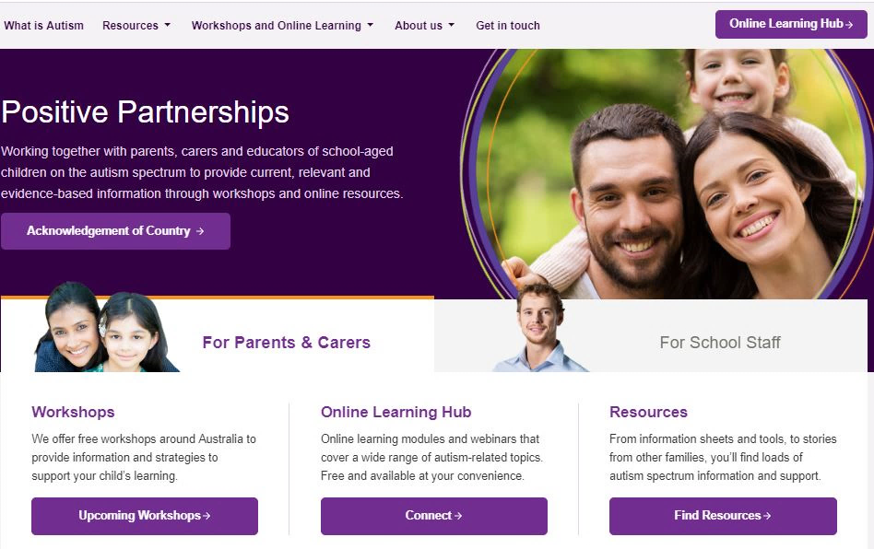


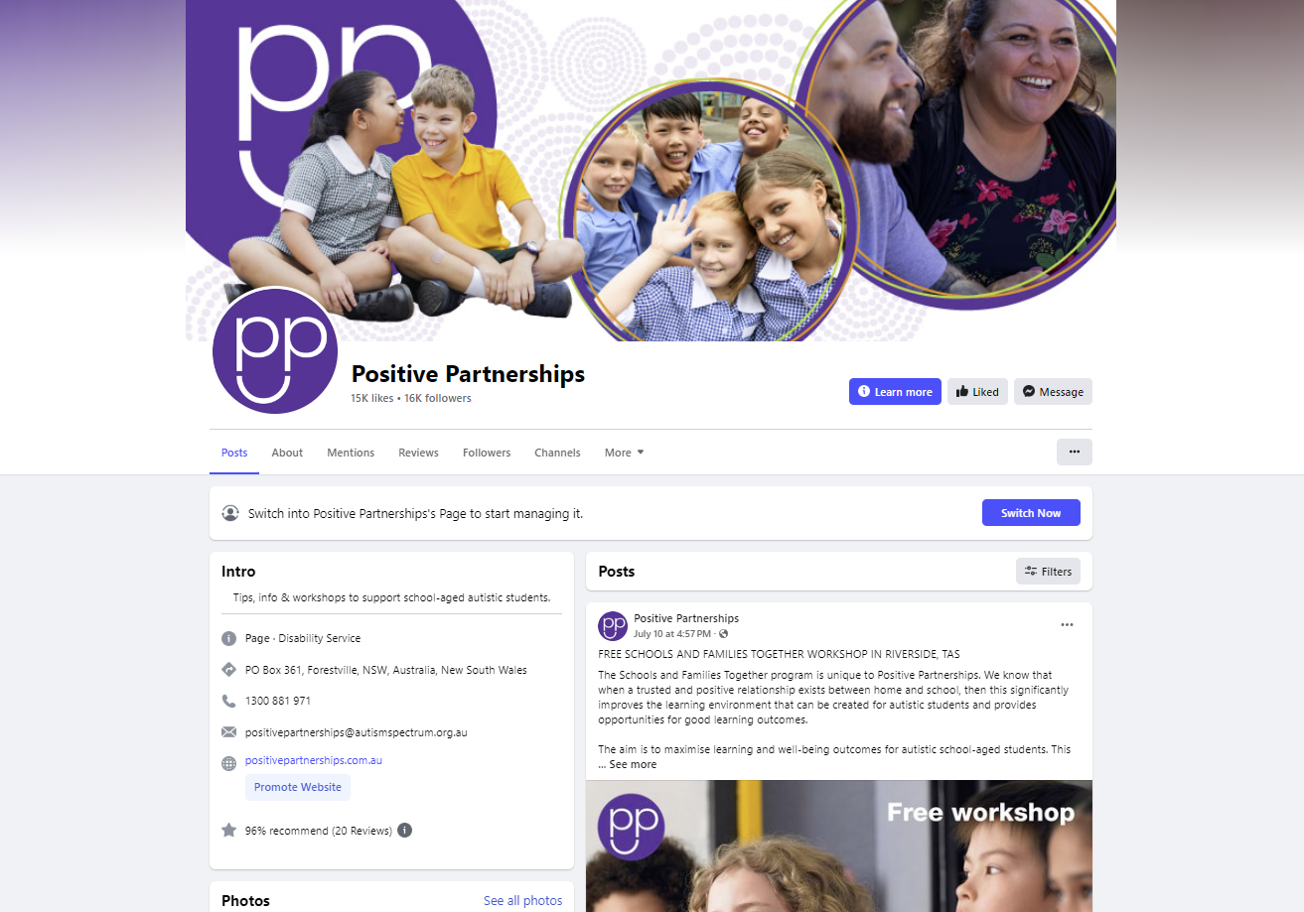

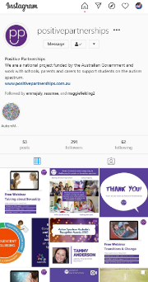


Resources
LinkedIn Positive Partnerships
Instagram @positivepartnerships
Threads @positivepartnerships
pinterest.com.au/
PositivePartnershipsAustralia/
facebook.com/PositivePartnershipsAU
positivepartnerships.com.au
Notes:
SUGGESTED TIME: 1 min · 3:54 - 3:55
PURPOSE
Show where to follow Positive Partnerships online.
WHAT TO DO
1. Leave the slide up briefly so participants can note or photograph the handles.
RESOURCES
Positive Partnerships website - positivepartnerships.com.au
Facebook - facebook.com/PositivePartnershipsAU
Instagram - @positivepartnerships
Threads - @positivepartnerships
LinkedIn - Positive Partnerships
Pinterest - pinterest.com.au/PositivePartnershipsAustralia/

Slide 10

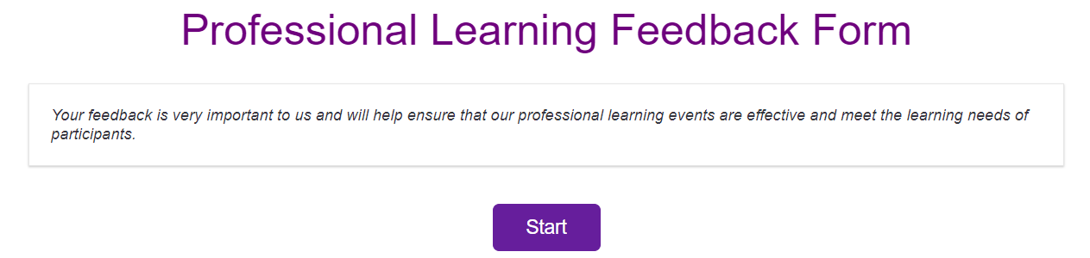
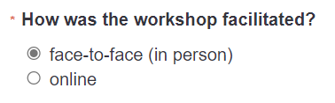
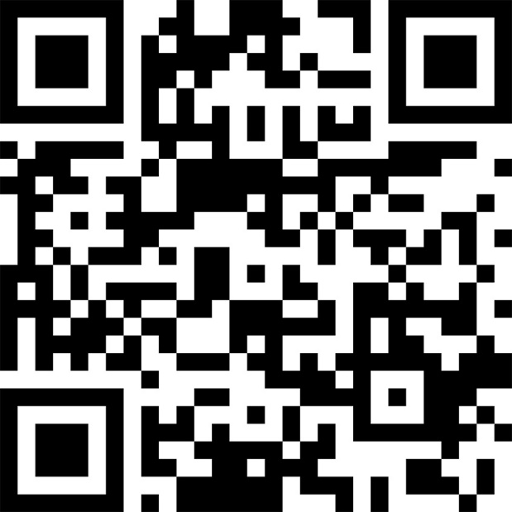
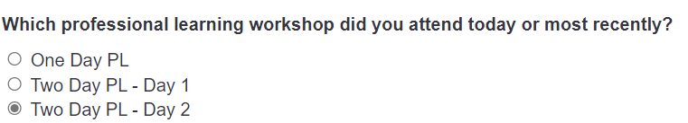

Feedback
http://tiny.cc/PP-PLfeedback
Notes:
SUGGESTED TIME: 4 min · 3:55 - 3:59
PURPOSE
Collect participant feedback.
WHAT TO DO
1. Explain why feedback is being collected and how it is used.
2. Show how to access the form (link and QR code).
3. Allow protected time for completion in the room.
4. Provide an accessible alternative if the process includes one.
RESOURCES
Feedback form - http://tiny.cc/PP-PLfeedback

Slide 11

Good luck on your journey
Stay curious.
Keep students at the centre.
Take one thoughtful next step, include the people who hold relevant knowledge and review what happens. Small, informed changes can be refined through student voice, observation and partnership.
Notes:
SUGGESTED TIME: 1 min · 3:59 - 4:00
PURPOSE
Close warmly and return participants to student-centred curiosity.
WHAT TO DO
1. Thank participants for their attention, questions and the close knowledge of students they brought to the day.
2. Invite them to stay curious and keep students at the centre.
3. Remind participants to take their action card and conversation plan.
4. State the relevant follow-up and contact arrangements.
KEY MESSAGES
• Stay curious.
• Keep students at the centre.
• Small, informed changes can be reviewed and refined in partnership.

